Slide 1



SAP Cloud Platform – Cloud Foundry Training
Training for Ernst & Young

Slide 2


DISCLAIMER
The training content and delivery of this presentation is confidential, and cannot be recorded, or copied and distributed to any third party, without the written consent of Imarticus Learning Pvt. Ltd.

Slide 3

Introduction

Slide 4

LEARNING OBJECTIVES
Introduction to SAP Cloud Platform
Differentiate Between On-premise v/s Cloud
Explain Why SAP Cloud Platform is Used
Define What is Cloud Foundry & Give its Brief History
Discuss the Internal Architecture of Cloud Foundry
List the Installing tools – CLI, Git, Maven, STS, VS Code, Jenkins, PostgreSQL
Describe How to Setup your SAP Cloud Trial Account, Global Account, Subaccount, Org and Space Usage
Build your First SAP CF App using Java
Explain the Micro-service Architecture
Define Spring, Dependency Injection
Explain pom.xml and Getting Dependencies from Maven Repository
Demonstrate How to Add Dependencies in pom.xml, and Check new Jar Files in eclipse and Using Spring Starter Project
Create a Simple web service
Create a CURDQ Application using Spring boot and PostgreSQL
Explain How to Run PostgreSQL in SAP CF, Manifest.yml file and Deploy application to CF

Slide 5
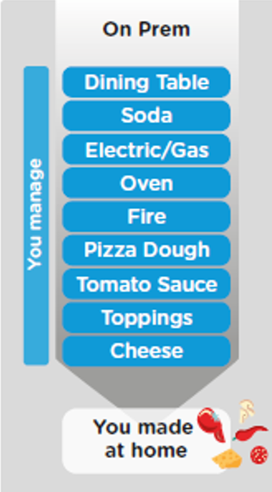
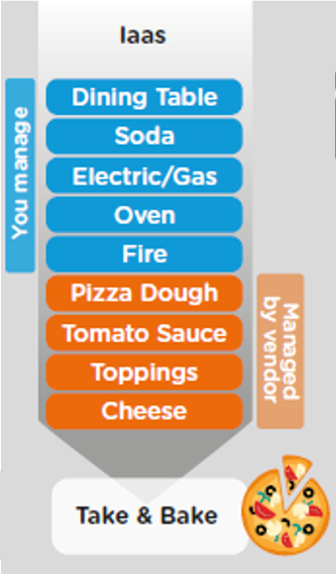
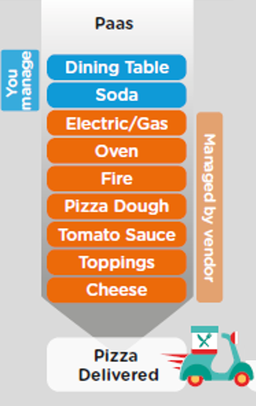
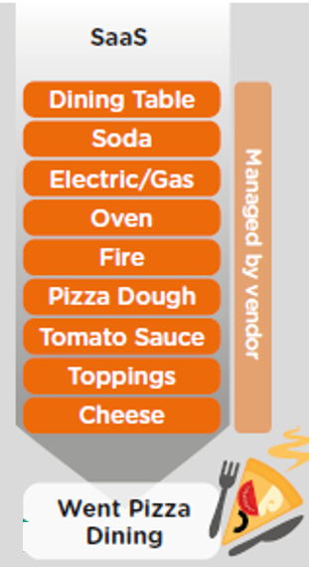
ON-PREMISE V/S CLOUD

Slide 6
TYPE OF CLOUD OFFERINGS
Application
Application As a Service
Customer Managed
Customer Managed
Customer Managed
SAP Managed
Data
Runtime
Platform as a Service
SAP/Partner Managed
Middleware
Database
OS
Virtualization
Infrastructure as a Service
SAP/Partner Managed
Servers
Storage
Networking

Slide 7


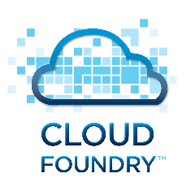

WHAT IS SAP CLOUD FOUNDRY?
Application
Application
Data
Data
Runtime
Platform as a Service
Managed by SAP implementing open source CF
Middleware
Fully ready landscape with reusable services
Scalability
Elasticity
Low TCO
Database
OS
Managed by Infrastructure
providers
Data Centers
Service Portfolio
Virtualization
Infrastructure as a Service
Servers
Storage
Networking

Slide 8
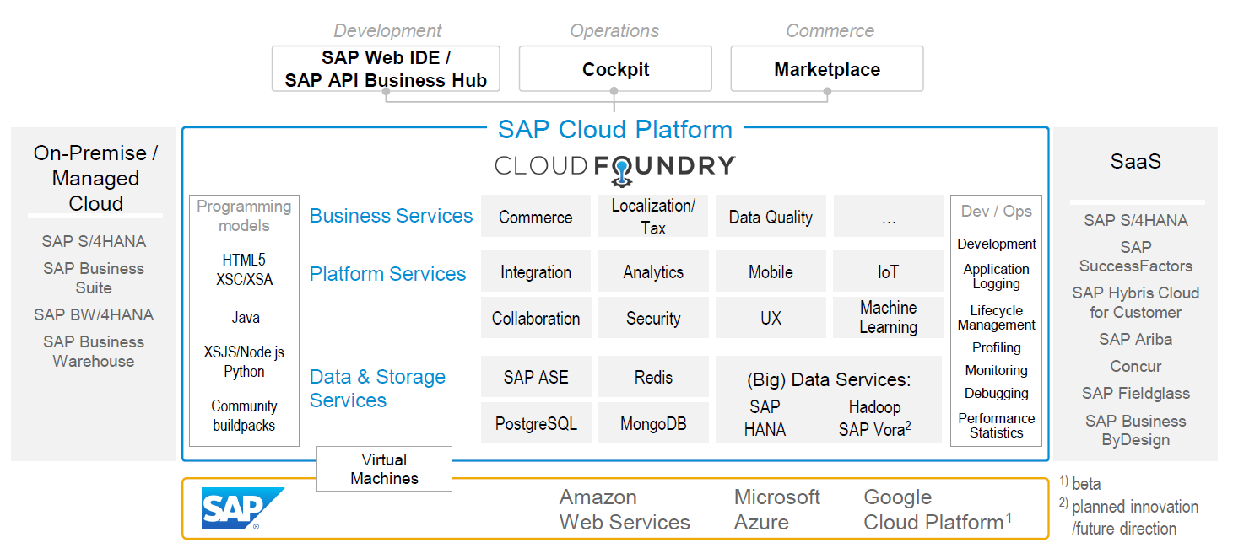
SAP CLOUD FOUNDRY ARCHITECTURE
SAP Business Application Studio

Slide 9
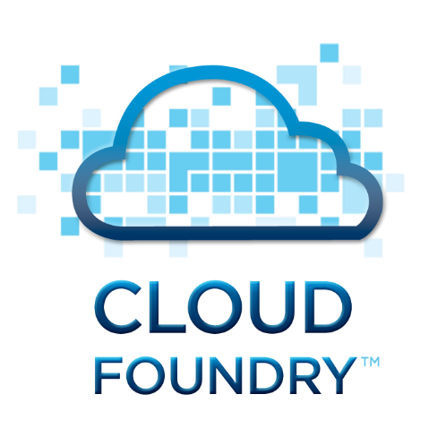




WHY CLOUD FOUNDRY
1
Support full development lifecycle
Build Application & Services
Development
Continuous Delivery (CD) = Code ➔ Push ➔ Test ➔ Build
Continuous Integration (CI) = Dev ➔ Quality ➔ Production
Up and Down
Deployment
Testing
Monitor and Upgrade

Slide 10

WHY CF
2
Self healing container management system
Cell
Garden = execution
Containers
A

Slide 11
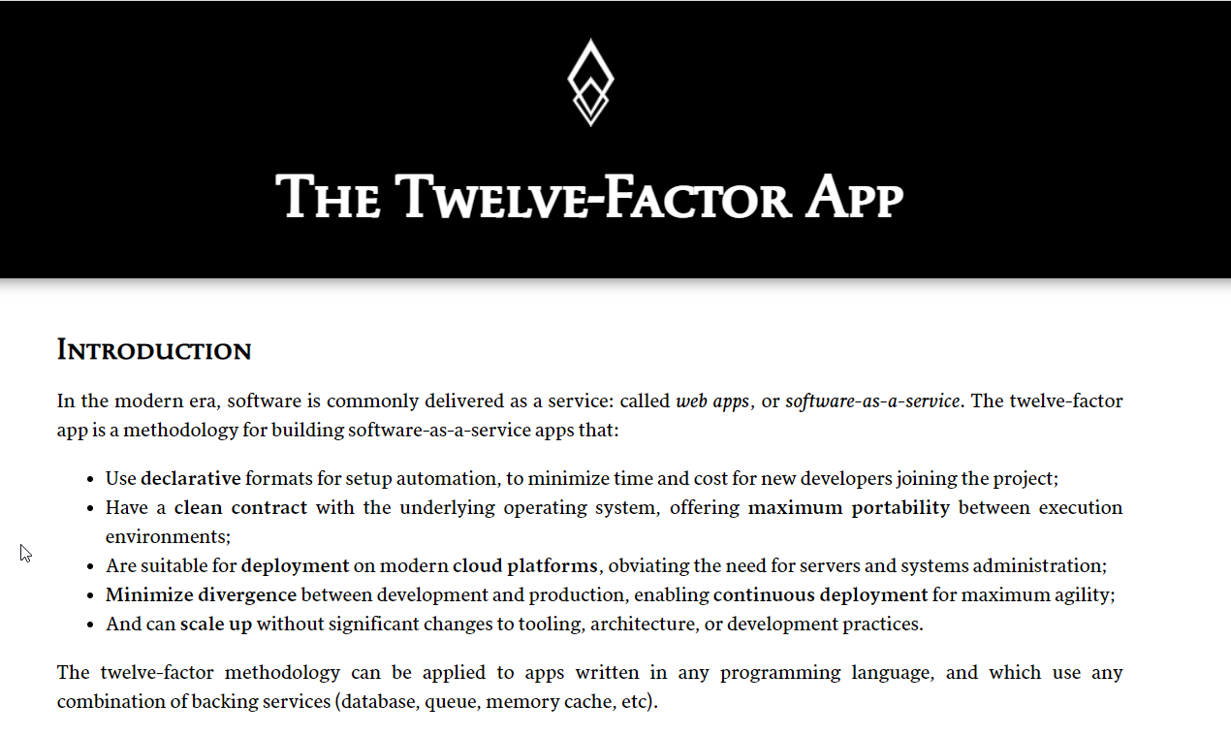

WHY CF?
3
Support 12 Factor App
It is a strategy to build software-as-a-service
https://12factor.net/
A

Slide 12
HISTORY OF CF
License: Apache 2.0
Build in Ruby, Java and Go
Open Governance Foundation
2009-2011
2012
2013
2014
2015
2019
2021
VMWare
BOSH
Open Source Tools
Seven platinum members and two gold members
40+ Members
65+ Members
Jan 2021
Pivotal Cloud foundry closes free trials
Pivotal
EMC
VMWare
General Electric

Slide 13
SETUP CLOUD PLATFORM ACCOUNT STRUCTURE
Backing Services
Global Account
(Representation of customer for billing purpose)
Sub Account
(per region)
Specialized service offerings
Represents LoB
Space quotas
1 *
1 *
Space
1
*
Apps

Slide 14
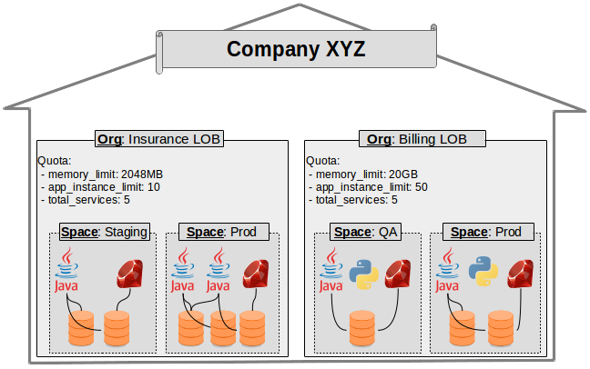
EXAMPLE – CF ORG STRUCTURE

Slide 15
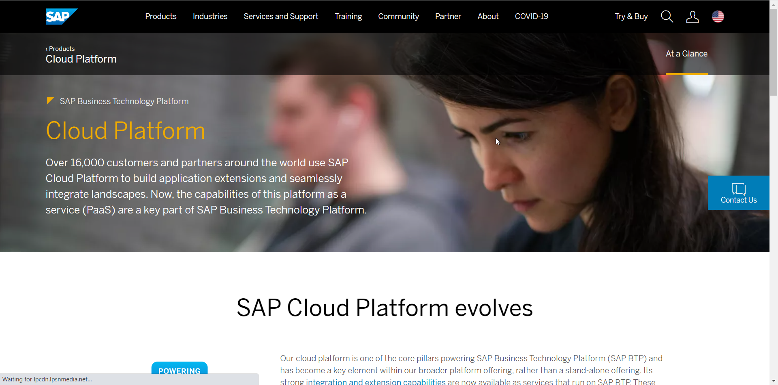
HANDS-ON – SETUP YOUR ACCOUNT
Setup your SAP Cloud Foundry Account

Slide 16
HANDS-ON – INSTALLING TOOLS
CF CLI
https://drive.google.com/file/d/1uKgZcNa0V77kxrJIEtMrzpdWb1HACDgu/view?usp=sharing
Git
https://git-scm.com/downloads
Maven
https://maven.apache.org/download.cgi
STS
https://spring.io/tools
VS Code
https://code.visualstudio.com/
Jenkins
https://www.jenkins.io/download/
PostgreSQL
https://www.postgresql.org/

Slide 17
HANDS-ON – CREATE AND DEPLOY YOUR FIRST APP
Download a simple go-lang application and deploy to CF.

Slide 18
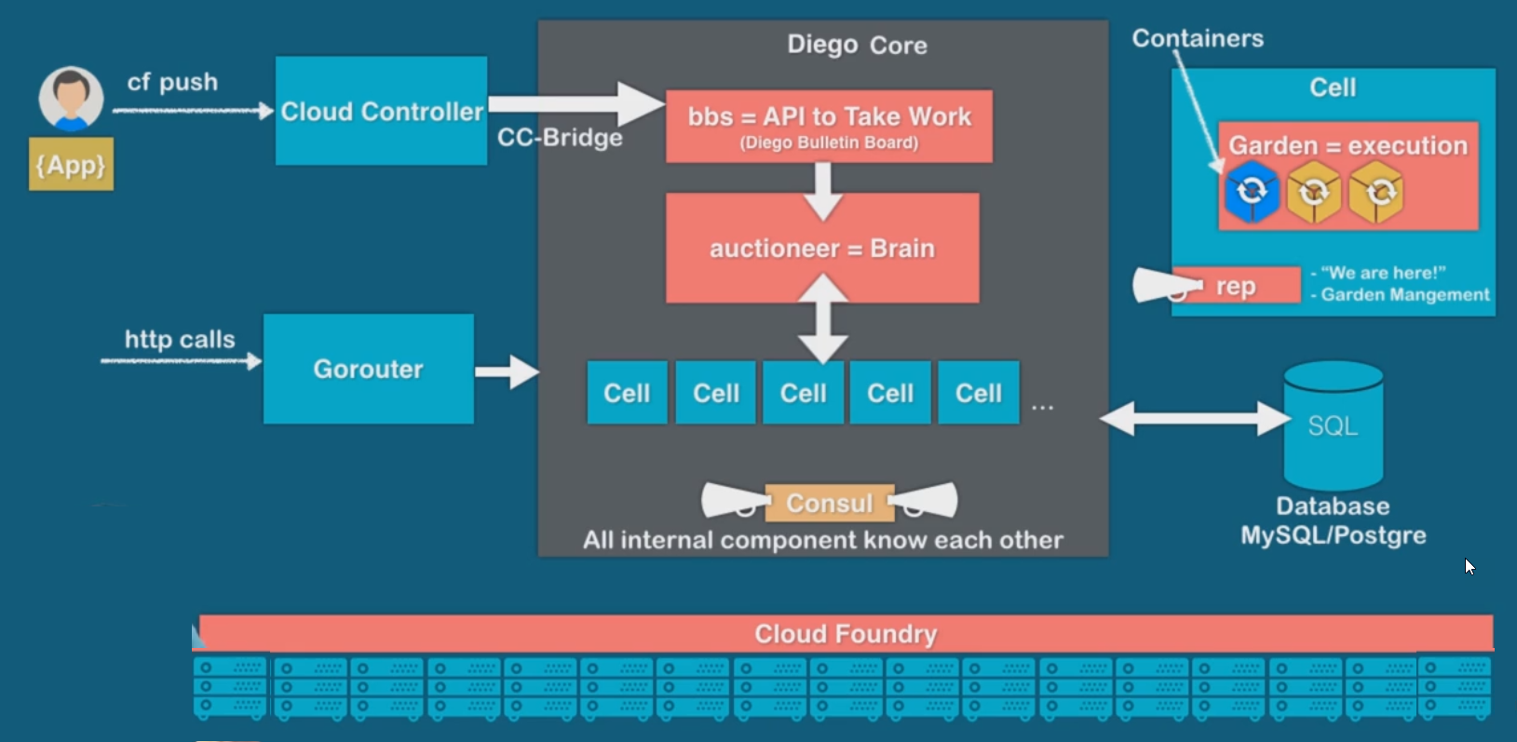
UNDER THE HOOD

Slide 19
Break

Slide 20
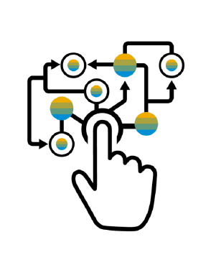
MICROSERVICE – SAP’S TRADITIONAL DEVELOPMENT AND DEPLOYMENT MODEL
Characteristics of the traditional model
SAP systems are one large logical system with a single (SQL) DB
Transactional consistency for all data is guaranteed
Big, infrequent releases with high risk
Hard to apply cloud requirements
Monolith must be built, tested, deployed, and scaled as a whole
Vertical scaling* is limited, cost is non-linear
Systems often poorly utilized (dev-test, non-peak-times)
High availability setup requires almost double the infrastructure
“Microservice architecture is an approach to developing a single application as a suite of small services, each running in its own process and communicating with lightweight mechanisms, often an HTTP REST API. These services are built around business capabilities and independently deployable by fully automated deployment machinery.”

Slide 21
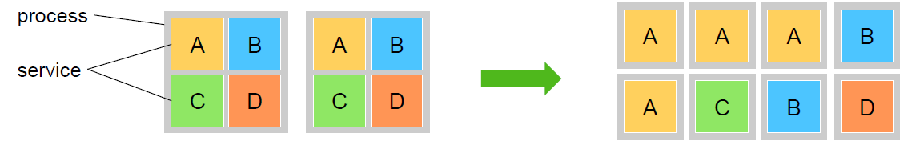
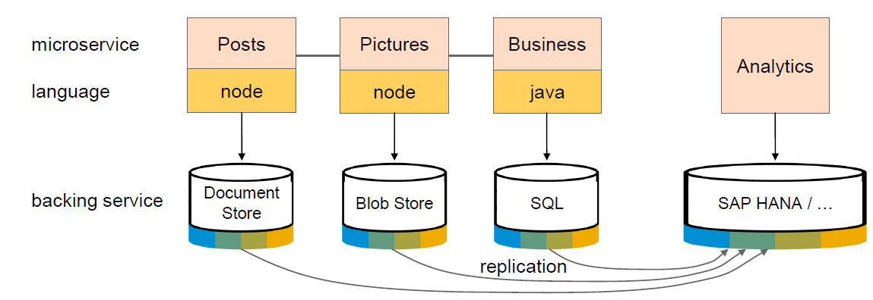
ADVANTAGES
Each microservice runs in a separate process / container.
This enables them to
Be deployed individually and frequently
(Auto)scale independently to varying loads
You can use technologies and languages that best fit the problem *
Microservices are self-contained, i.e. no shared data stores (!)
Using the right tools impacts productivity and performance

Slide 22
IN NUTSHELL
Microservices are the building blocks of cloud applications
Microservices implement one concept well (from DB to UI)
Microservices scale horizontally via processes
Microservices allow resilience against software and hardware failures
Microservices can be deployed independently, support continuous delivery
Microservices can use different technologies

Slide 23
INTRODUCTION TO SPRING, DEPENDENCY INJECTION
The Spring Framework provides a comprehensive programming and configuration model for modern Java-based enterprise applications - on any kind of deployment platform.
A key element of Spring is infrastructural support at the application level: Spring focuses on the "plumbing" of enterprise applications so that teams can focus on application-level business logic, without unnecessary ties to specific deployment environments.
The key advantage of spring framework are
Dependency Injection (Inversion of Control – IOC)
Light Weight
Loosely Coupled
Provides libraries for Runtime Environment
We can work with POJO (Pain Java Objects)
Testing (because we can change objects at runtime)

Slide 24
SPRING BOOT
Open Source Java based framework which is used to create spring projects which are production ready.
Advantage
Saves time
Provides all dependency
Developer can scaffold project types
Different options for deployment

Slide 25
HANDS-ON : SPRING BASICS
Create a Simple Airplane application which allows to command flight operations to planes by replacing wings easily.
Bean
SpringBoot Application
Airplane
Fly()
IWings
Boing
Airbus
Solution:
https://github.com/soyuztechnologies/00springboot.git
Components

Slide 26
HANDS-ON- CREATE FIRST SPRING MICROSERVICE
Design a Microservice which returns data for different vendors.
Browser
ServletInitializer
Application
@RestController
VendorController
@Component
Vendor
Solution:
https://github.com/soyuztechnologies/01RestService.git

Slide 27
HANDS-ON: CREATE CURDQ APP FOR LOCAL POSTGRESQL
Design an Entity of Vendor and its address in the Spring boot app
Connect the application to the PostgreSQL in local system
Implement and test all CURDQ operations using REST API
Id
firstName
lastName
companyName
Website
emailId
gstNo
Vendor
Id
type
street
city
country
region
Address
1
*

Slide 28
HANDS-ON: CREATE CURDQ APP FOR CF POSTGRESQL
Create a PostgreSQL Service in SAP CF
Connect to the service and test the app
# ===============================
# = DATA SOURCE
# ===============================
# Set here configurations for the database connection
spring.datasource.url=jdbc:postgresql://connectionurl:5432/mufpwelo
spring.datasource.username=userName
spring.datasource.password=password
spring.datasource.driver-class-name=org.postgresql.Driver
spring.jpa.show-sql=true
# Hibernate ddl auto (create, create-drop, update): with "create-drop" the database
# schema will be automatically created afresh for every start of application
spring.jpa.hibernate.ddl-auto=create
# Allows Hibernate to generate SQL optimized for a particular DBMS
spring.jpa.properties.hibernate.dialect=org.hibernate.dialect.PostgreSQLDialect

Slide 29
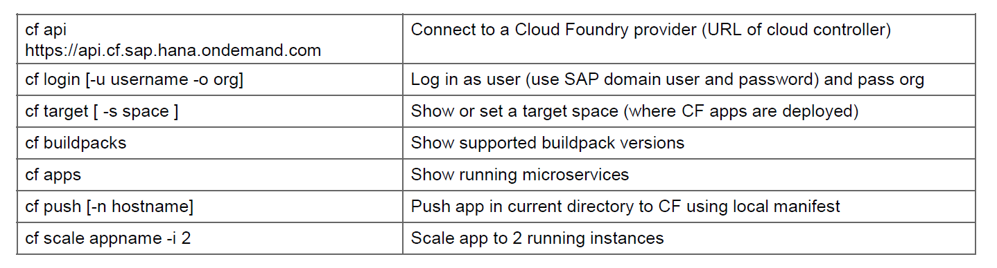
HANDS-ON: DEPLOY CURDQ APP IN CF
Add manifest.yml file to the app
Deploy the app to CF
---
applications:
- name: dbboot
random-route: true
memory: 1024M
path: /target/02dbboot-0.0.1-SNAPSHOT.war
buildpacks:
- java_buildpack
Solution:
https://github.com/soyuztechnologies/02dbboot.git

Slide 30
HANDS-ON: CREATE A GITHUB REPOSITORY
Create an Account on https://www.github.com
Push your code to github

Slide 31
CONFIGURE CI PIPELINE
Create a CI pipeline using Jenkins
Configure Jenkins Server
Install Git Repository Plugin and Test(GitHub plugin)
Install Maven Plugin and Link to Jenkins( Maven Integration plugin )
Install Maven in System where Jenkins is Running
Set Classpath(M2_Home=Installation, M2=Bin File) and Test mvn –version
Install Maven Integration and Maven Invoker Plugin
Global Tool Configuration, Give Path M2_Home and Path
Test the Git and Maven, location of war file is in:
Install Cloud Foundry Plugin and Add to the Jenkins Task in Post build Actions
6. Provide Details of :
Cloud Foundry: API, Email and Password, Organization and Space is needed
7. Create a manifest.yml file and add content of path, application name etc.
8. Add Build Triggers and enable ‘Build whenever a SNAPSHOT dependency is built’
and Poll SCM with * * * * * for building every minute

Slide 32

Summarize
LET’S SUMMARISE!

Slide 33

Summarize
End of Day 1

Slide 35



We’re committed to empower you to be
#FutureReady
through powerful training solutions.
We build the workforce of the future.
250+
Corporate Clients
30,000+
Learners Trained
25000+
Learners Placed
FREE WEBINARS
Sign up for free webinars with industry experts every fortnight!
Enroll Now!
Contact us today!
https://imarticus.org/

